Slide 1

Gate Level Minimization
CSE 4205 Digital Logic Design
Course Teacher: Md. Hamjajul Ashmafee
Lecturer, CSE, IUT
Email: ashmafee@iut-dhaka.edu

Slide 2
Remaining to Add
Review other books and internet resources
Notes:
What is digital computer? Examples where we can use this thing.

Slide 3
To be noted more:
Circuit diagrams of NAND and NOR implementation
3.7 – other two level implementation
Is XNOR satisfies associative law?? – even function??
Slide 52 (Few important points)
Quine McClusky method/ tabular method
Takes notes shortly from book
Draw the figures clearly

Slide 4
Introduction
Gate level minimization
A design task to get optimized digital circuit
But difficult for manual approach when the number of inputs are many
Contemporary computer applications can easily minimize it efficiently
So, we need to understand the underlying mathematical description

Slide 5
Implementation of Boolean Function
Complexity of implementing digital logic gates of any Boolean function depends on the complexity of its algebraic expression.
A Boolean function can be expressed in different ways, but their truth table representation is unique
This Boolean expression can be simplified by Boolean algebra (Cut-and-try method)
But it’s manual and there’s no specific rules to proceed next step
Map method or Veitch/Karnaugh Map or K-map
Simple and straightforward procedure to minimize Boolean function
Also be regarded as pictorial form of a truth table

Slide 6
The Map Method – K-map
K-map is made of squares
Each square represents a minterm of the function
Graphical representation of a Boolean function in the map enclosing those squares whose minterms are included in the function
This representation reveals all possible ways a function may be expressed in standard form (SOP or POS)
A designer should identify various patterns to derive alternative simplified algebraic expression
A super optimized expression contains minimum number of terms and with smallest possible number of literals in each term
But sometimes more than one expressions may satisfy this minimization criteria – all of them are correct
Notes:
Target:
Make the group of 1s which are adjacent by edge and maintain the count as 2^{n}
Cover all the minterms at least once [more than one might cause redundant terms in the simplified expression]
Try to make the group larger to get shorter expression [as expected]
To do this if it requires to repeat a covered minterm, it is acceptable.

Slide 7
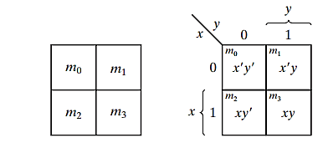
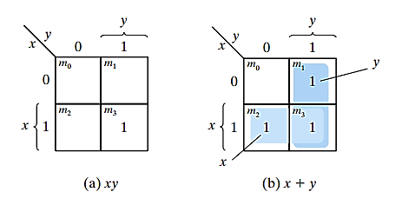
Two-Variable K-map
Two variables – Four minterms
Four Squares in K-map
Another way to represent any of the 16 functions of two variables
Minterm corresponding to a square can be obtained from the concatenation of the row and column number
Note: A square is marked with 1, if that minterm asserts the function
Notes:
AND operation
xy = already in minterms
OR operation
x+y = it is not in canonical form – must be converted considering all possible minterms
= x(y+y’) + y(x+x’)

Slide 8
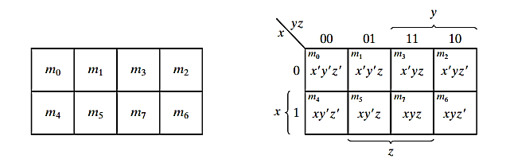
Three-Variable K-Map
Three variables – Eight minterms
Eight squares in k-map
Minterms are expressed symbolically in binary equivalent sequence but arranged in k-map as a sequence of reflected code
Only one-bit changes in value from one adjacent column to the next
Any two adjacent squares in the map differ by only one variable
Basic property of K-map
Notes:
In four squares, each variable is 1 (expressed as unprimed)
In other four squares, each variable is 0 (expressed as primed)

Slide 9



Three-Variable K-Map: Simplification
If any two adjacent squares (vertically or horizontally) are considered as sum of them, those two minterms could be simplified to a single product term following the postulates of Boolean algebra ($i.e. y+y’=1$).
Dissimilar variable will be removed
Example: m₅ and m₇
Note: Two squares are adjacent even though they don’t touch each other
Like world map
Example: m₀ and m₂
$m5 + m7$
$$=xy^{′}z+xyz$$
$$=xz\left(y+y′\right)$$
$$=xz$$
Notes:
Verification: (Just like a rolled paper)
m₀ +m₂ = ?
m₄ +m₆ = ?

Slide 10


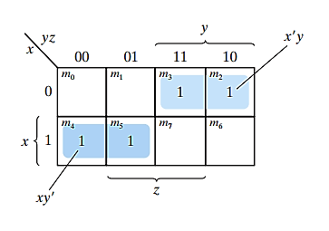
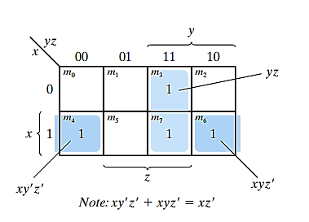


3-variable K-Map: Example
$$F =x^{′}yz +x^{′}yz′ +xy^{′}z′ +xy^{′}z$$
$$F =x′yz +xy′z′+ xyz′ + xyz$$
Notes:
Answer:
$x’y +xy’$
$yz +xz’$

Slide 11

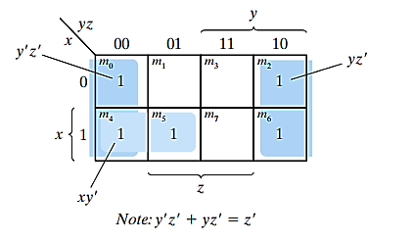
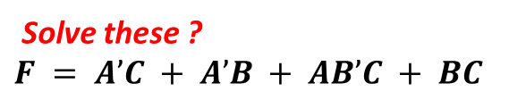
3-variable K-Map: Example…
Note:
Like this, 4 adjacent squares are also possible following same postulates of Boolean algebra
Use of squares more than once (repeatedly) makes a term more minimized
If the function is not expressed in canonical form, missing minterms should be obtained
Minimized function must be expressed in standard form
Solve these ?
$$F = A’C + A’B + AB’C + BC$$
Notes:
= m₀ + m₂ + m₄ + m₆ = ? ($Answer: z’$)
Answer:
$$F = z’ +xy’$$
$$F=C+A^{′}B$$

Slide 12
4-Variable K-Map
4 variables – 16 minterms
16 squares in K-map
Both columns and rows are numbered in Gray code sequence
Only one variable change in any two adjacent squares row-wise or column-wise
The map is considered on the surface whose top and bottom edges and right and left edges are attached to each other to form adjacent squares
Notes:
Verification: (Just like a rolled paper)
m₀ +m₂ = ?
m₃ +m₁₁ = ?

Slide 13
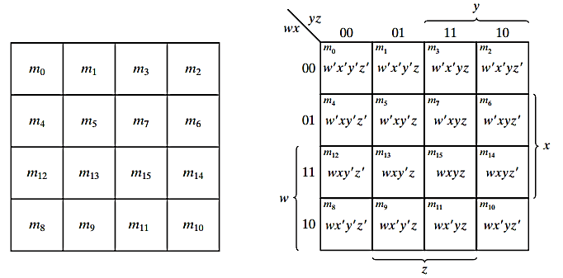
4-Variable K-Map: Representation
Notes:
Show how to calculate the minterm number.

Slide 14
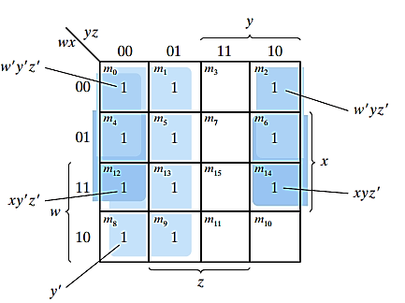

4-Variable K-Map: Example
Solve this:
Notes:
Answer:
$y^{′}+w^{′}z^{′}+xz^{′}$
$B^{′}D^{′}+B^{′}C^{′}+A′CD′$

Slide 15
Basic Definition: Implicant
Implicant is a group of adjacent squares in K-map consisting of 2^{n} 1s representing true minterms in the function
Alternatively, Implicant is a product term (or minterm) of any function so that it implies the function (i.e., if the implicant is true, the function will be true)
A prime implicant is a product term obtained by combining the maximum possible number of adjacent squares in the map.
Where, this number satisfies 2^{n}
A single square itself represents a prime implicant if it has no other adjacent 1’s square
Essential prime implicant, is that prime implicant that has at least one minterm which is not covered by any other prime implicants.
This prime implicant must be included in the simplified expression
Notes:
To minimize the function:
We must cover all minterms that asserts the function
Number of the terms in the simplified expression must be minimum
No redundant term should be in minimized expression. (i.e., all the minterms of a group are already covered by other group)
There may have more than one expressions those satisfy these criteria

Slide 16
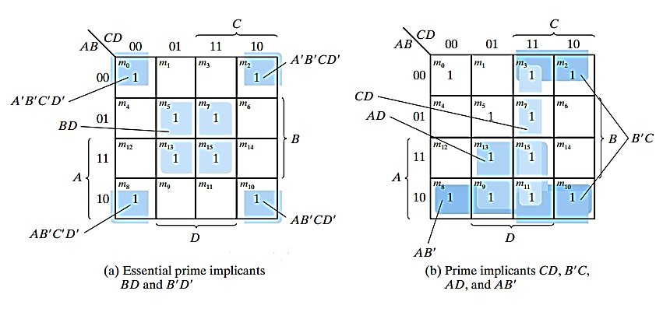
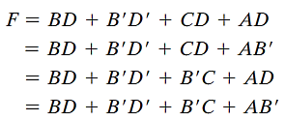



Basic Definition: Implicant – Example
$F(A,B,C,D)=\sum{(0,2,3,5,7,8,9,10,11,13,15)}$
$$B’D’$$
$$BD$$
1. The essential prime implicants are the
only ways to cover some minterms
2. There are more alternatives of prime
implicants to cover remaining minterms
Notes:
To minimize the function:
We must cover all minterms that asserts the function
Number of the terms in the simplified expression must be minimum
No redundant term should be in minimized expression. (i.e., all the minterms of a group are already covered by other group)
There may have more than one expressions those satisfy these criteria

Slide 17
Implicants in 3- and 4-variable K-map
3 variable K-map
One square – a term with three variables
One minterm itself
Two adjacent squares – a term with two variables
Four adjacent squares – a term with one variable
Eight adjacent squares – always 1
Constant function
4 variable K-map
One square – a term with four variables
One minterm itself
Two adjacent squares – a term with three variables
Four adjacent squares – a term with two variables
Eight adjacent squares – a term with three variables
Sixteen adjacent squares – always 1
Constant function

Slide 18
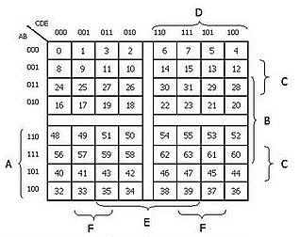
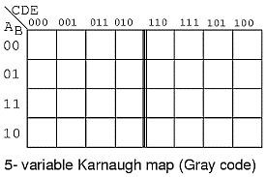
5- and 6-Variable K-Map
DEF
ABC
6-variable K-map
Notes:
Show how m₁₈ and m₅₀ are adjacent
Maps with 5 or more variables are not simple to manage as the number of minterms in such maps is 32 or more and a complex geometry is involved to find out adjacent squares

Slide 19
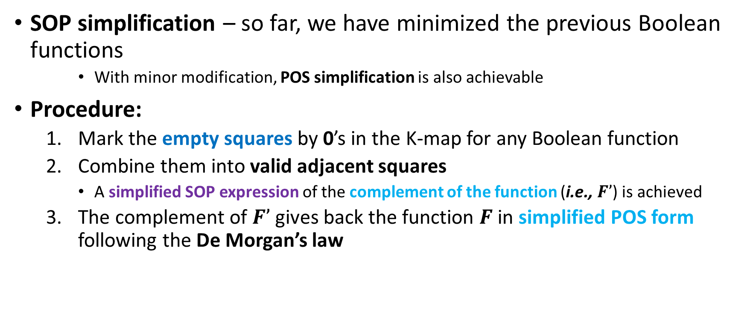
POS & SOP Simplification
SOP simplification – so far, we have minimized the previous Boolean functions
With minor modification, POS simplification is also achievable
Procedure:
Mark the empty squares by 0’s in the K-map for any Boolean function
Combine them into valid adjacent squares
A simplified SOP expression of the complement of the function (i.e., $F’$) is achieved
The complement of $F’$ gives back the function $F$in simplified POS form following the De Morgan’s law

Slide 20
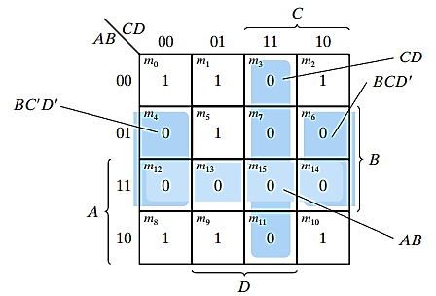
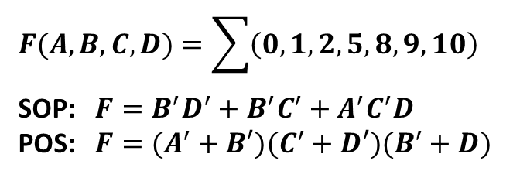

POS & SOP Simplification - Example
$F(A,B,C,D)=\sum{(0,1,2,5,8,9,10)}$
Simplification in SOP and POS form
$$F(A,B,C,D)=\sum{\left(0,1,2,5,8,9,10\right) }$$
SOP: $F=B^{′}D^{′}+B^{′}C^{′}+A^{′}C^{′}D$
POS: $F=(A^{′}+B′)(C^{′}+D′)(B^{′}+D)$

Slide 21
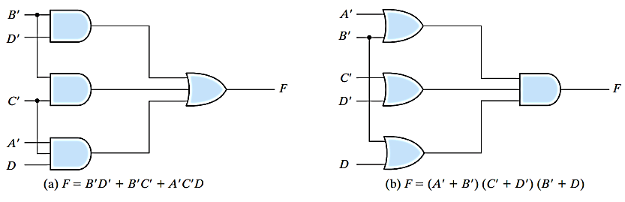

POS & SOP Simplification – Gate Level Implementation
$F(A,B,C,D)=\sum{(0,1,2,5,8,9,10)}$
Gate level implementation of simplified SOP and POS expressions
Notes:
It is assumed that input variables are also available in their complement directly
Implementation of standard form is said to be a two-level implementation
But sometimes two-level implementation is impractical if the number of inputs are so many (more than hundreds or thousands)

Slide 22
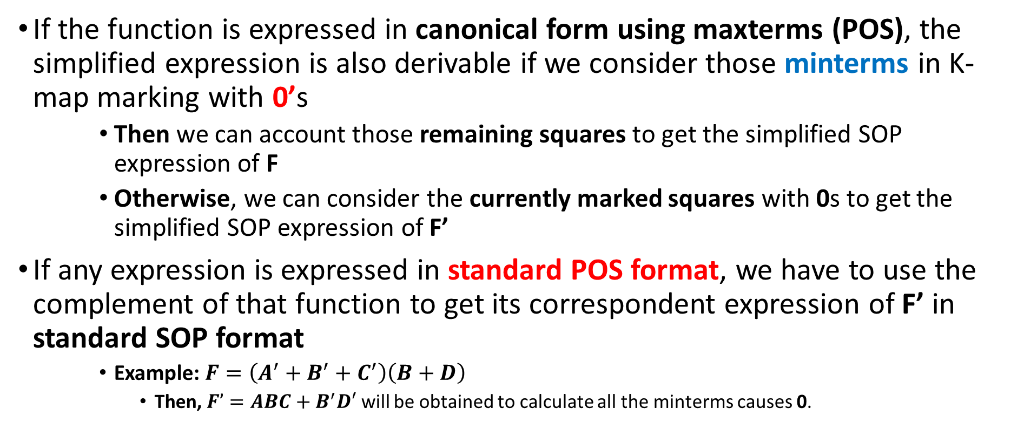
POS & SOP Simplification – Important
If the function is expressed in canonical form using maxterms (POS), the simplified expression is also derivable if we consider those minterms in K-map marking with 0’s
Then we can account those remaining squares to get the simplified SOP expression of F
Otherwise, we can consider the currently marked squares with 0s to get the simplified SOP expression of F’
If any expression is expressed in standard POS format, we have to use the complement of that function to get its correspondent expression of F’ in standard SOP format
Example: $F=\left(A^{′}+B^{′}+C^{′}\right)\left(B+D\right)$
Then, $F’=ABC+B^{′}D′$ will be obtained to calculate all the minterms causes 0.

Slide 23
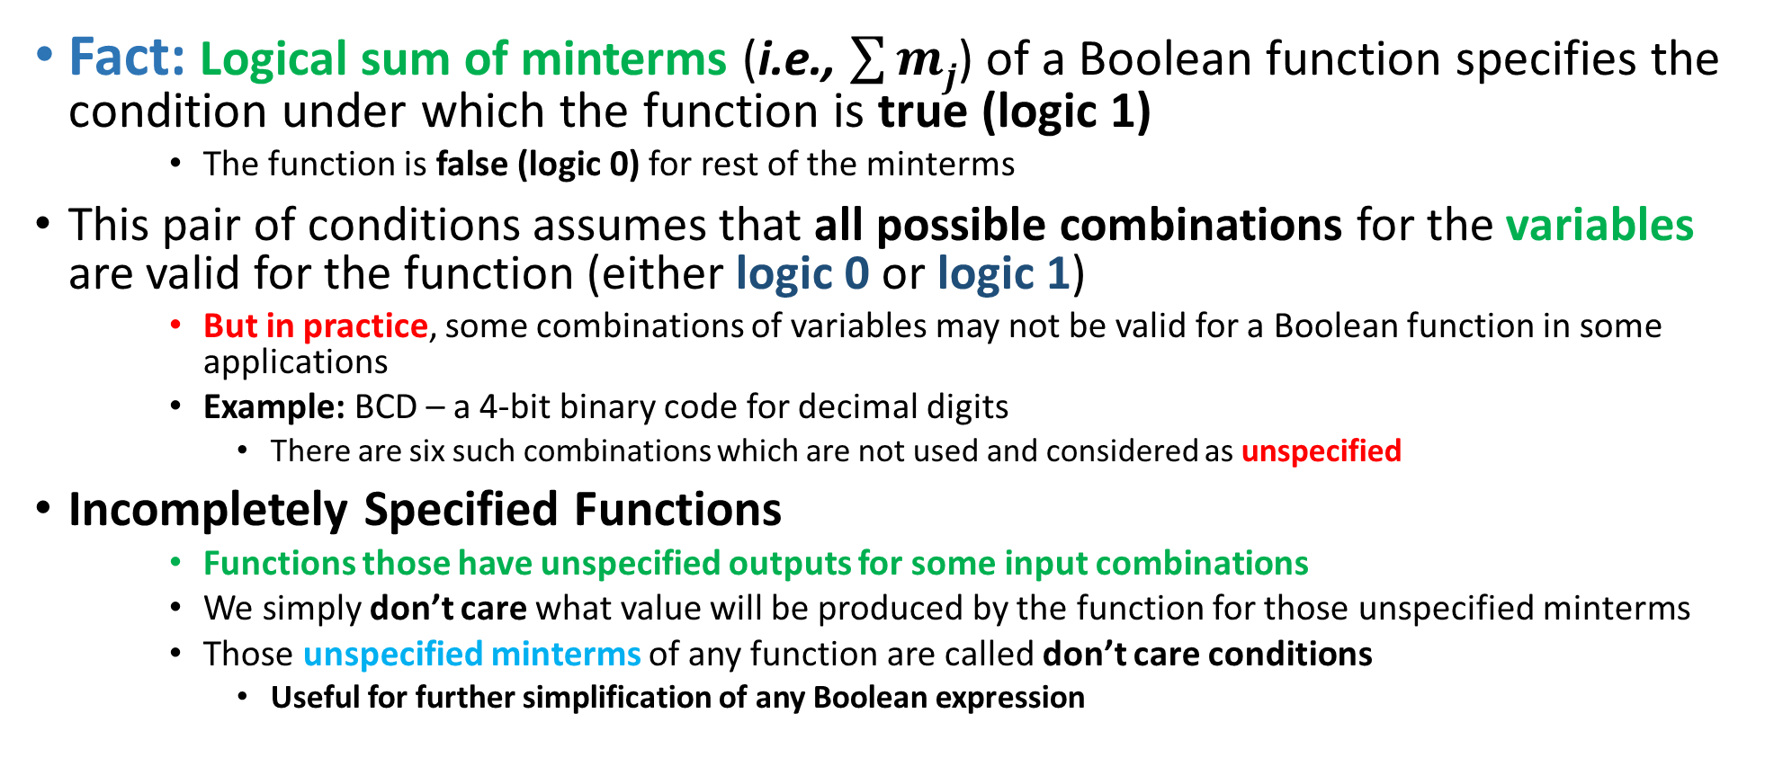
Incompletely Specified Functions Don’t Care Conditions
Fact: Logical sum of minterms (i.e., $\sum{mj}$) of a Boolean function specifies the condition under which the function is true (logic 1)
The function is false (logic 0) for rest of the minterms
This pair of conditions assumes that all possible combinations for the variables are valid for the function (either logic 0 or logic 1)
But in practice, some combinations of variables may not be valid for a Boolean function in some applications
Example: BCD – a 4-bit binary code for decimal digits
There are six such combinations which are not used and considered as unspecified
Incompletely Specified Functions
Functions those have unspecified outputs for some input combinations
We simply don’t care what value will be produced by the function for those unspecified minterms
Those unspecified minterms of any function are called don’t care conditions
Useful for further simplification of any Boolean expression
Notes:
Unspecified minterms – minterms which are not of our interest rather ignore when they are produced

Slide 24
Don’t Care Conditions
A don’t care minterm is a combination of variables whose logical value (0 or 1) is not specified (i.e., defined) in the Boolean function
So that corresponding square can’t be marked with 1 or 0 in the K-map
Rather “X” could be placed in that corresponding square distinguishing from 0 and 1
It indicates that we don’t care whether the value of 0 or 1 is assigned to that function for that minterm
For better simplification, adjacent don’t care square may be assumed to be either 0 or 1
Preference of 0 or 1 depends on which combination gives the simplest expression
Trick: To get the simplified expression of any Boolean function, we must include all 1s, but we may or may not include any of the Xs based on preference
Initially, those don’t care minterms could be unspecified, but when a particular choice is made, they should be treated differently.
Notes:
Note: When a don’t care minterm is selected as a true minterm, that should be treated as 1 and then other don’t care minterms should be treated as false minterm

Slide 25
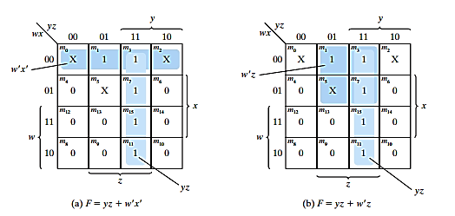
Don’t Care Conditions – Example
Note: It is also possible to simplify in POS form using its complement. i.e., $F’ = z’+wy’$
Notes:
Though these two functions are not algebraically equal, both of them cover all specified minterms.
In the first choice, minterm 0 and 2 are treated logic-1 and minterm 5 is treated logic-0
In the second choice, minterm 5 is treated logic-1 and minterm 0 and 2 are treated logic-0
As we are considering this incompletely specified function, the only difference between these two functions are in don’t care minterms

Slide 26
NAND & NOR implementation
Digital circuits are frequently constructed with NAND or NOR gates rather than AND, OR and NOT gate because:
These gates are easier to fabricate with electronic components
They are used as basic gates in all ICs
Any logic circuits can be implemented with these gates
So, they are called universal gates
Because of prominence of these gates, some rules and procedures have been developed to convert any circuit using AND, OR and NOT gates into equivalent circuit using NAND or NOR gates

Slide 27
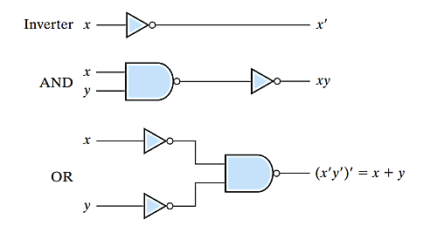
NAND implementation
To show that any function can be implemented with NAND gate, we need only to show AND, OR and NOT gates obtained with NAND gates alone
Note: One-input NAND gate behaves exactly like an inverter.
Notes:
A convenient way to implement a Boolean function with NAND gates is to obtain the simplified Boolean function in terms of Boolean operators (i.e., AND, OR, NOT) and then convert the function to NAND logic
All inputs of any gate (for any multi-input gate) are merged together to generate one input gate – like inverter

Slide 28

NAND Implementation: Graphic Symbols
To facilitate the conversion to NAND logic, it is convenient to define an alternative graphic symbol for the NAND gate
AND-invert: Consists of an AND gate followed by a small bubble (i.e., complement)
Invert-OR: Consists of an OR gate preceded by a bubble in each input (i.e., complements each input)
Both of them are equal because of De Morgan's theorem
Useful for analysis and design NAND circuits

Slide 29
Two Level NAND Implementation
For two level NAND implementation, initially the function must be simplified in SOP form
AND gate will be replaced by AND-invert NAND gate in the first level and OR gate will be replaced by invert-OR NAND gate in the second level
As Bubble denotes complementation, two cascaded bubbles will be cancelled by each other
But, if there is a single-variable term in first level of implementation, an inverter will be required for that term
We can replace that inverter changing the input variable into its complement (i.e., x will be x’ in the input)

Slide 30
Two Level NAND Implementation: Procedure
Simplify the function and express it in SOP form
To implement the first level gates, all product terms of the expression (having at least two variables) drawn with NAND gates
Inputs of these NAND gates will be the same literals of the previous terms
Draw another single NAND gate (representing invert-OR) in the second level with inputs coming from outputs of the first level gates
A term having a single-variable term requires an inverter in the first level. However, if that variable is complemented, it can be connected directly to the input of the second level NAND gate

Slide 31
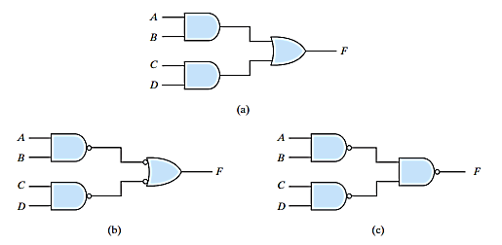

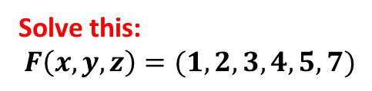
Two Level NAND Implementation - Example
Example: $F =AB+CD$
The NAND implementation can be verified algebraically using De Morgan’s law
Verification: $F ={\left({\left(AB\right)}^{′}{\left(CD\right)}^{′}\right)}^{′}=AB+CD$
Solve this: $$F\left(x,y,z\right)=(1,2,3,4,5,7)$$
Notes:
Answer: $F=xy^{′}+x^{′}y+z$

Slide 32
NOR implementation
NOR operation is the dual of NAND operation
All procedures and rules for NOR logic are the dual of the corresponding procedures and rules developed for NAND logic
Another universal gate to implement any logic circuit

Slide 33
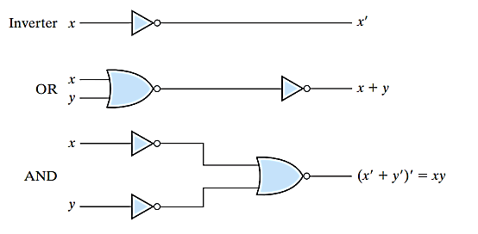
NOR implementation
To show that any function can be implemented with NOR gate, we need only to show that AND, OR and NOT gates obtained with NOR gates alone
Note: One-input NOR gate behaves exactly like an inverter.
Notes:
A convenient way to implement a Boolean function with NOR gates is to obtain the simplified Boolean function in terms of basic Boolean operators and then convert the function to NOR logic

Slide 34
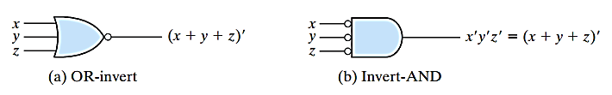
NOR Implementation: Graphic Symbols
To facilitate the conversion to NOR logic, it is convenient to define an alternative graphic symbol for the NOR gate
OR-invert: Consists of an OR gate followed by a small bubble (i.e., complement)
Invert-AND: Consists of an AND gate preceded by a bubble in each input (i.e., complements each input)
Both of them are equal because of De Morgan's theorem
Useful for analysis and design NOR circuits

Slide 35
Two Level NOR Implementation
For two level NOR implementation, initially the function must be simplified in POS form
Note: Simplified POS expression can be obtained by combining all 0s and complementing that expression
OR gate will be replaced by OR-invert NOR gate in the first level and AND gate will be replaced by invert-AND NOR gate in second level
As Bubble denotes complementation, two cascaded bubbles will be cancelled by each other
But, if there is a single-variable term in first level of implementation, an inverter will be required for that term
We can replace that inverter changing the input variable into its complement (i.e., x will be x’ in the input)

Slide 36
Two Level NOR Implementation: Procedure
Simplify the function and express it in POS form
To implement the first level gates, all sum terms of the expression (having at least two variables) drawn with NOR gates
Inputs of these NOR gates will be the same literals of the previous terms
Draw another single NOR gate (representing invert-AND) in the second level with inputs coming from outputs of the first level gates
A term having a single variable requires an inverter in the first level. However, if that variable is complemented, it can be connected directly to the input of the second level NOR gate

Slide 37
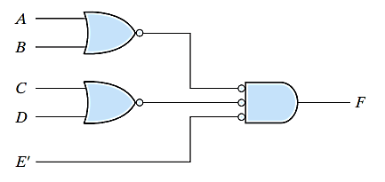

Two Level NOR Implementation - Example
Example: $F =\left(A+B\right)\left(C+D\right)E$
The NOR implementation can be verified algebraically using De Morgan’s law
Verification: $F ={\left({\left(A+B\right)}^{′}+{\left(C+D\right)}^{′}+E′\right)}^{′}=(A+B)\left(C+D\right)E$

Slide 38
Multiple Level NAND Implementation
Standard form in SOP or POS expression can be implemented in a two-level implementation
But sometimes, three or more level getting structure are also observed in digital systems
There are two approaches to design a multi-level NAND circuits:
Express the Boolean function in terms of AND, OR and NOT operators
Two alternative ways:
Approach 1: All the AND, OR and NOT gates would be converted to its corresponding NAND representation
Approach 2: Convert each AND to AND-invert and each OR to Invert-OR gates
There should have two cascaded bubbles or inverters who will cancel each other
Otherwise, one extra inverter should be inserted, or input variables should be complemented

Slide 39
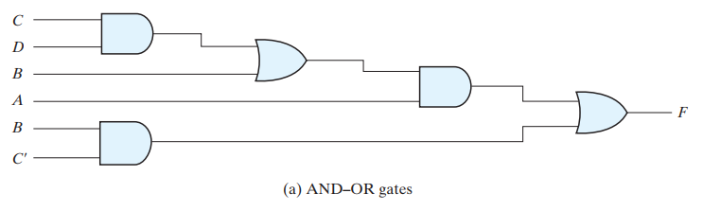
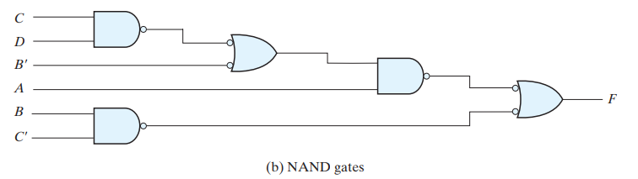

Multiple Level NAND Implementation: Example
Example 1: $F=A\left(CD+B\right)+BC^{′}$
We could simplify this expression to its SOP form, but here a multilevel NAND circuit is preferred
Approach 1

Slide 40
Multiple Level NAND Implementation: Example
Example 1: $F=A\left(CD+B\right)+BC^{′}$
We could simplify this expression to its SOP form, but here a multilevel NAND circuit is preferred
Approach 2

Slide 41
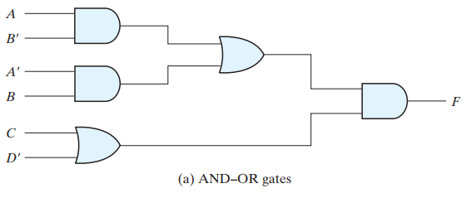
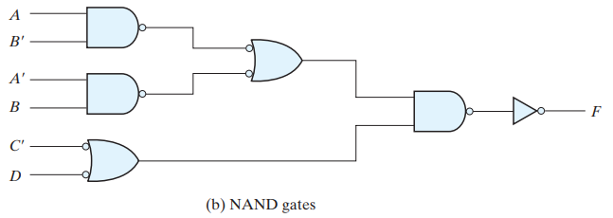

Multiple Level NAND Implementation: Example…
Example 2: $F=\left(AB^{′}+A^{′}B\right)(C+D′)$
We could simplify this expression to its SOP form, but here a multilevel NAND circuit is preferred
Approach 1

Slide 42
Multiple Level NAND Implementation: Example…
Example 2: $F=\left(AB^{′}+A^{′}B\right)(C+D′)$
We could simplify this expression to its SOP form, but here a multilevel NAND circuit is preferred
Approach 2

Slide 43
Multiple Level NOR Implementation
There are two approaches to design a multi level NOR circuits:
Express the Boolean function in terms of AND, OR and NOT operators
Two alternative ways:
Approach 1: All the AND, OR and NOT gates would be converted to its corresponding NOR representation
Approach 2: Convert each AND to invert-AND and each OR to OR-invert gates
There should have two cascaded bubbles or inverters who will cancel each other
Otherwise, one extra inverter should be inserted, or input variables should be complemented

Slide 44
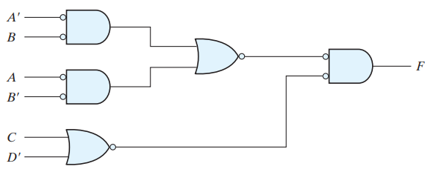

Multiple Level NOR Implementation- Example
Example 1: $F=\left(AB^{′}+A^{′}B\right)(C+D′)$
We could simplify this expression to its POS/SOP form, but here a multilevel NOR circuit is preferred
Approach 1

Slide 45

Multiple Level NOR Implementation- Example…
Example 1: $F=\left(AB^{′}+A^{′}B\right)(C+D′)$
We could simplify this expression to its POS/SOP form, but here a multilevel NOR circuit is preferred
Approach 2

Slide 46
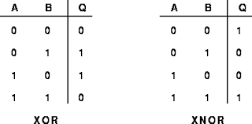

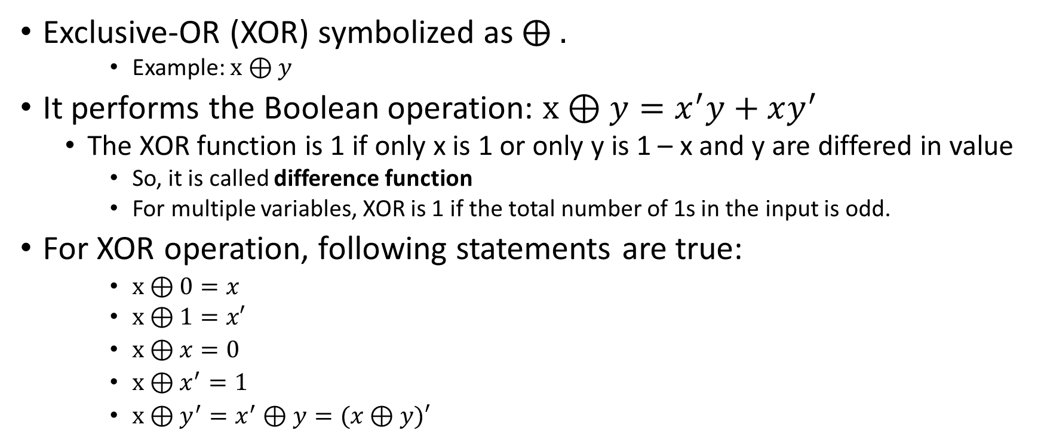
Exclusive-OR Function
Exclusive-OR (XOR) symbolized as $⨁{ . }$
Example: $x⊕y$
It performs the Boolean operation: $x⊕y=x^{′}y+xy^{′}$
The XOR function is 1 if only x is 1 or only y is 1 – x and y are differed in value
So, it is called difference function
For multiple variables, XOR is 1 if the total number of 1s in the input is odd.
For XOR operation, following statements are true:
$x⊕0=x$
$x⊕1=x′$
$x⊕x=0$
$x⊕x^{′}=1$
$x⊕y^{′}=x^{′}⊕y=(x⊕y)′$
Notes:
$x⊕y^{′}=x^{′}⊕y=xy+x^{′}y^{′}=(x⊕y)′$
These statements also could be verified with truth table

Slide 47
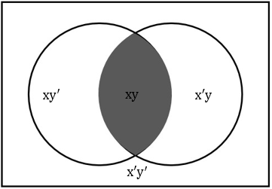
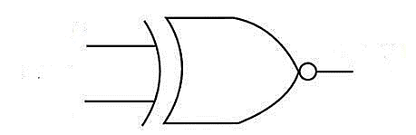
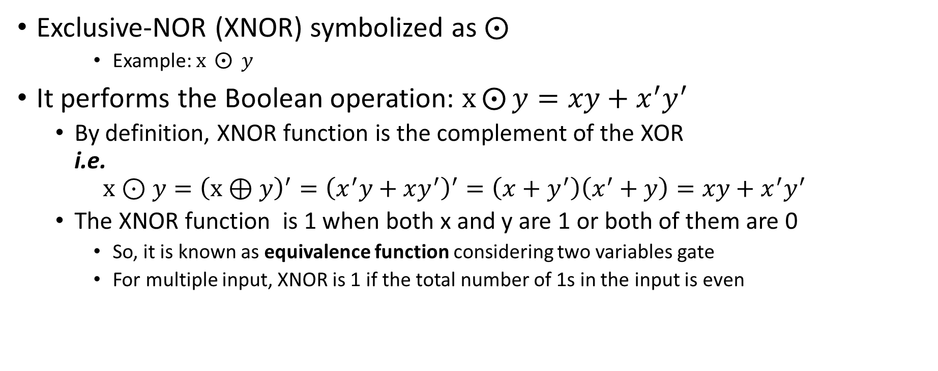
Exclusive-NOR Function
Exclusive-NOR (XNOR) symbolized as $⨀$
Example: $x ⨀{ y}$
It performs the Boolean operation: $x⨀{y}=xy+x^{′}y^{′}$
By definition, XNOR function is the complement of the XOR i.e.
$${x⊙y=\left(x⊕y\right)}^{′}={\left(x^{′}y+xy^{′}\right)}^{′}=\left(x+y^{′}\right)\left(x^{′}+y\right)=xy+x^{′}y^{′}$$
The XNOR function is 1 when both x and y are 1 or both of them are 0
So, it is known as equivalence function considering two variables gate
For multiple input, XNOR is 1 if the total number of 1s in the input is even

Slide 48
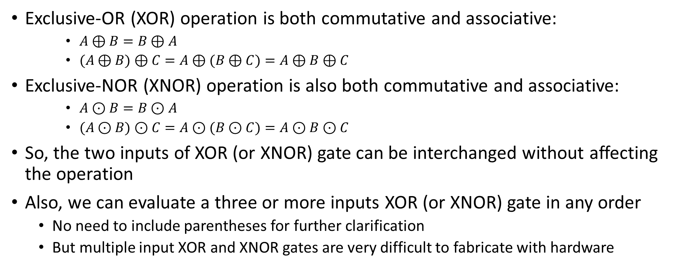
XOR an XNOR Function…
Exclusive-OR (XOR) operation is both commutative and associative:
$A⊕B=B⊕A$
$(A⊕B)⊕C=A⊕(B⊕C)=A⊕B⊕C$
Exclusive-NOR (XNOR) operation is also both commutative and associative:
$A⊙B=B⊙A$
$(A⊙B)⊙C=A⊙(B⊙C)=A⊙B⊙C$
So, the two inputs of XOR (or XNOR) gate can be interchanged without affecting the operation
Also, we can evaluate a three or more inputs XOR (or XNOR) gate in any order
No need to include parentheses for further clarification
But multiple input XOR and XNOR gates are very difficult to fabricate with hardware
Notes:
Even two input XOR and XNOR gate are constructed with other types of gates (i.e., AND, OR, NOT, NAND,…)

Slide 49
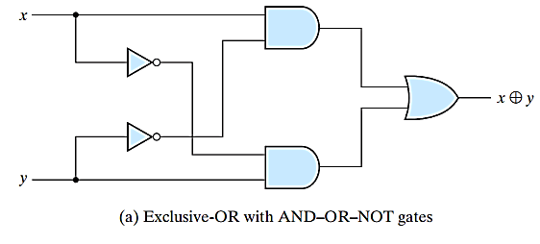
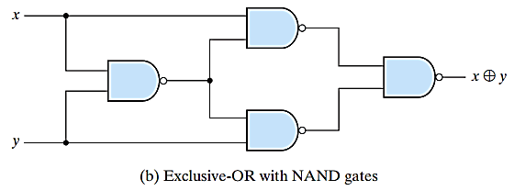
Implementation of XOR Gate
Notes:
Even two input XOR and XNOR gate are constructed with other types of gates (i.e., AND, OR, NOT, NAND,…)
Verify these circuit diagrams for better understanding

Slide 50


Implementation of XNOR Gate
XNOR gate with AND-OR-NOT gates
XNOR gate with NAND gates
Notes:
Even two input XOR and XNOR gate are constructed with other types of gates (i.e. AND, OR, NOT, NAND,…)
Verify these circuit diagrams for better understanding

Slide 51
Usage of XOR and XNOR Gates
Only a limited number of Boolean functions can be expressed with XOR and XNOR gates
In some digital system designs, they could be used
Specially, they are useful in -
Arithmetic operations (e.g., add, subtract, etc.)
Logical operation (e.g., complement)
Error detection and correction (e.g., parity generator and checker)
Gray code conversion
XOR gate is used extensively, XNOR could be implemented as XOR-inverter.

Slide 52



Odd Function with XOR gate Considering Logic-1
Basically, two input XOR gate could be defined as difference function
But, if we increase the number of input to three or more, definition will be changed
Example:
Here, three input XOR gate produces 1 if only one variable is 1 or all three variables are 1
Definition: A multiple input XOR gate operates as an odd function i.e. an odd number of inputs should be 1.
An n–variable XOR function is an odd function defined as the logical sum of the 2^{n}/2 minterms whose binary numerical values have an odd number of 1s
Notes:
So, to obtain even function considering logic-1, we need to use same XOR gate configuration with additional NOT gate at the end (i.e. complementing that XOR configuration = ($A⊕B⊕C)′=∑(0,3,5,6)$)
So last level XOR gate (output XOR gate) could be replaced with an XNOR gate. (Draw the diagram including an inverter with the above figure)
Here, the even function considering logic-1 will be 1 when an even number of its variables are 1 including that combination as well which has no variable equals 1.
An n–variable even function could be defined as the logical sum of the 2^{n}/2 minterms whose binary numerical values have an even number of 1s

Slide 53



Odd and Even Function with Four Variables Considering Logic-1
Algebraic expression of odd function with 4 variables:
Algebraic expression of even function with 4 variables:
($A⊕B⊕C⊕D)′=∑(0,3,5,6,9,10,12,15)$

Slide 54
Few Important Points***
For same odd number of variables, the XOR and XNOR function will produce same truth table
For same even number of variables, the XOR and XNOR function will produce opposite (complementary) truth table
Notes:
Here only “two input gate” system is considered

Slide 55
Application: Parity Generator and Checker
XOR function is very useful for error detection and correction codes
Parity bit is an extra bit which is usually included with original message during transmission for error detection
Parity Generator – the circuit that generates the parity bit in the transmitter
Parity Checker – the circuit that checks the parity in the receiver
Example:
Consider a three bit message (e.g. x, y, z) to be transmitted together with an even parity bit (e.g. P)

Slide 56



Parity Generator Circuit
In this circuit, three bits (i.e. x, y, z) in the message are inputs and even parity bit (i.e. P) is the output
For even parity, the bit P must be produced to make the total number of 1s (including P) even.
So, P makes an odd function, i.e. $P=x⊕y⊕z$

Slide 57



Parity Checker Circuit
In this circuit, four bits (i.e. x, y, z and P) in the transmitted message are inputs and error checker bit (i.e. C) is the output
For even parity checking, the checker bit C is 1 if an error occurs, i.e. if the total number of 1s in the received message is odd.
So, C makes another odd function, i.e. $C=x⊕y⊕z⊕P$
Notes:
This same circuit could be used as parity bit (P) generator if the input P in that circuit made ground (0) [to keep the z intact] and denote the output as C

Slide 58
Prime Implicants Selections

Slide 59
Prime Implicants Selections

Slide 60



The Tabular Method / Quine-McCluskey Method

Slide 61

The Tabular Method (Alternative Way)
(difference)
(old diff, new diff)

Slide 62

The Tabular Method
Verification using K-map:

Slide 63


Prime Implicants Determination
Another Example:

Slide 64


Prime Implicants Selections

Slide 65


The Tabular Method
Verification using K-map:

Slide 68
Administration

Slide 69
Administration

Slide 70
Administration

Slide 71
Administration

Slide 72
Administration

Slide 73
Administration

Slide 74
Administration

